Slide 1
Tasks: Heat safety in Longview Gardens
Which area is the hotspot
At which time of days the temp above 80°F
Bus stop at the hot spot
Nearby heat shelters and the open hour
Public facility-library, community center, recreation center,
Café ,bakery, store
Supermarket
Team: It's Saturday
Member: Joshua Giltinan and Yilin Giltinan

Slide 2
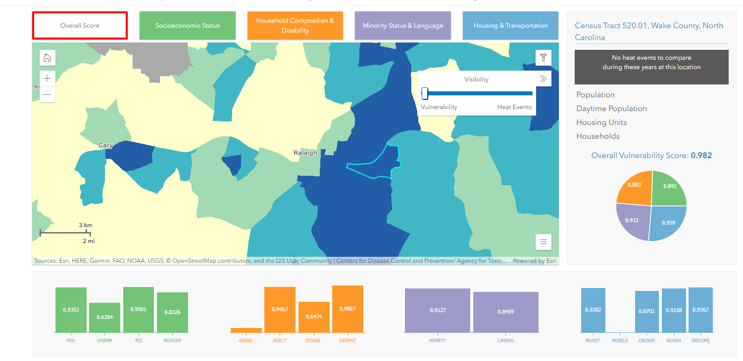
Why 520.01
(source: National integrated heat health information system)

Slide 3
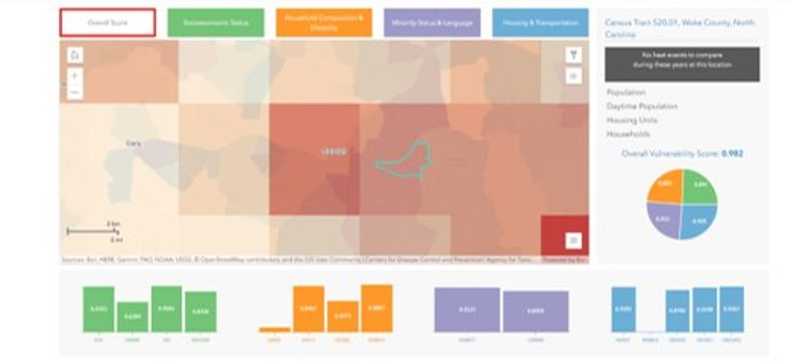
Why 520.01
(source: National integrated heat health information system)

Slide 4
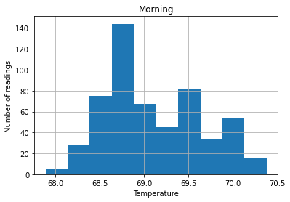
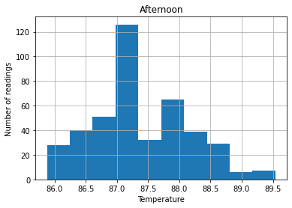
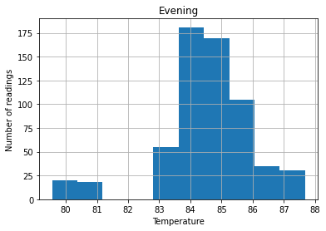
Temperature throughout the day
Tourism Score for North Carolina: 65°F and 80°F. (source:Weather Spark)

Slide 5
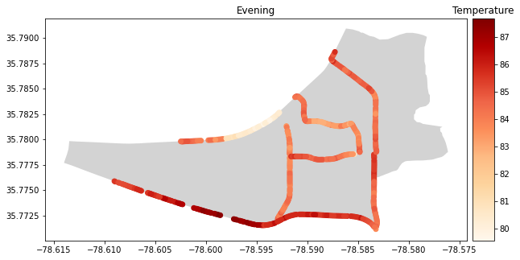
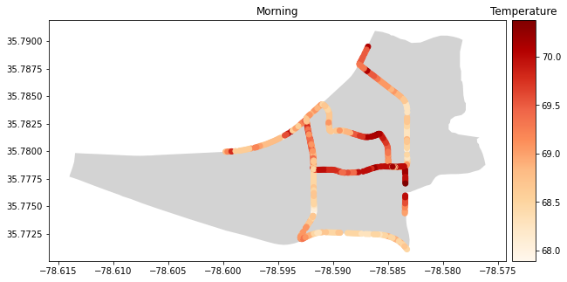
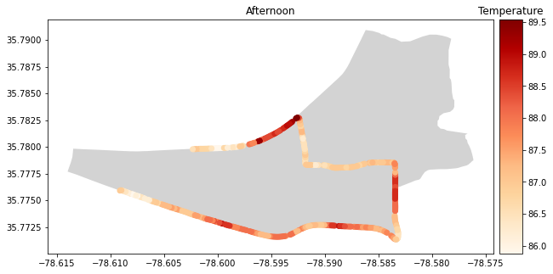
Temperature throughout the day

Slide 6
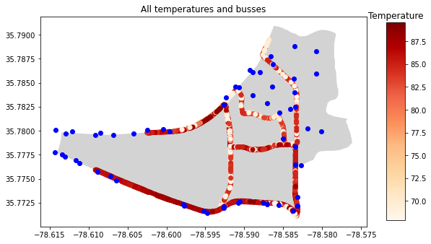
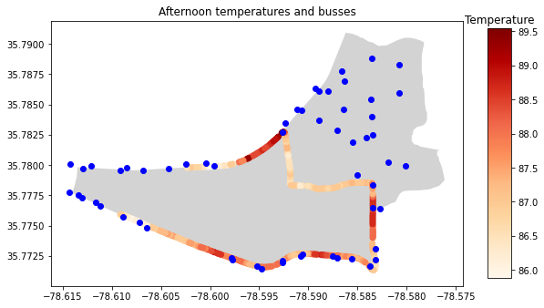
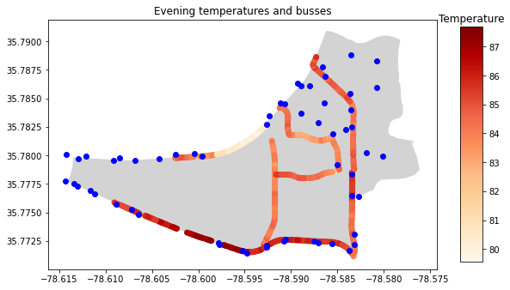
Temperature throughout the day
Critical
Bus Stops
按一下以新增文字
Cool path

Slide 7
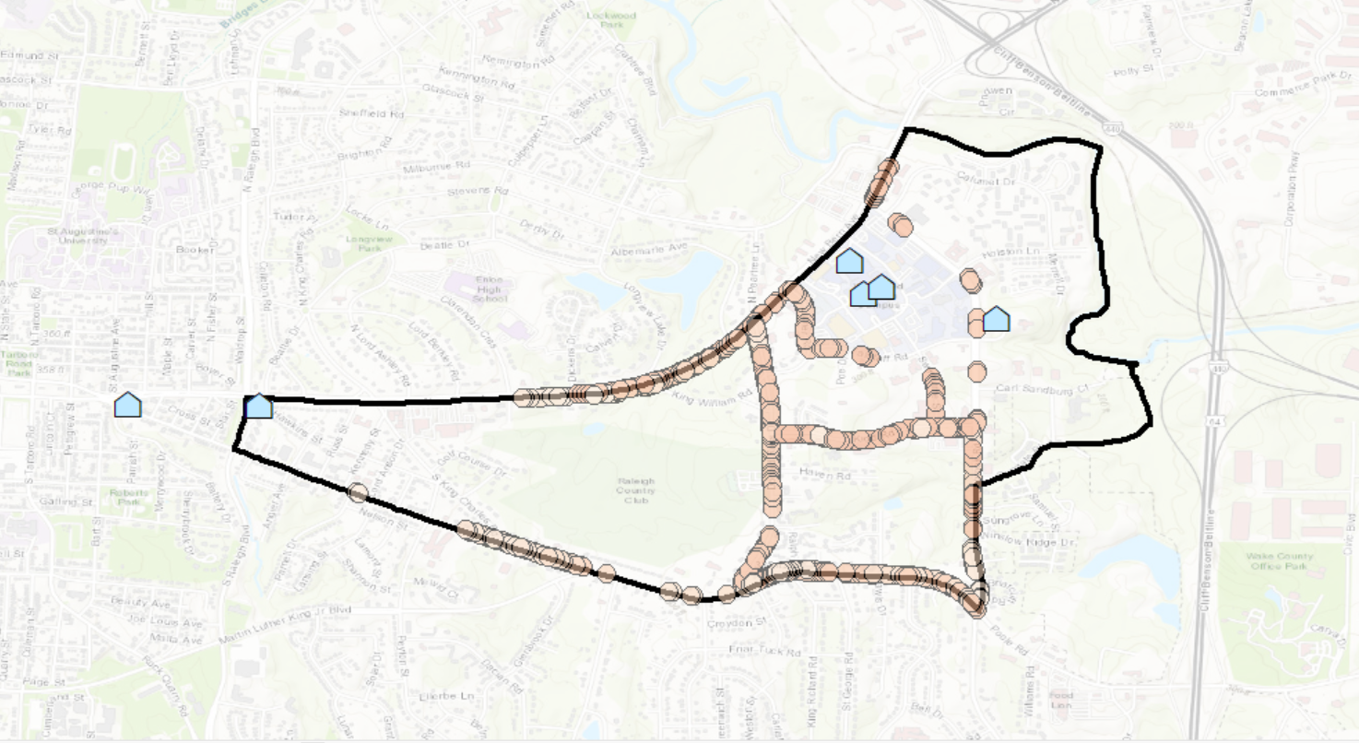
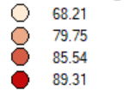

Heat distribution 6:00 am
Census track Boundary

Slide 8
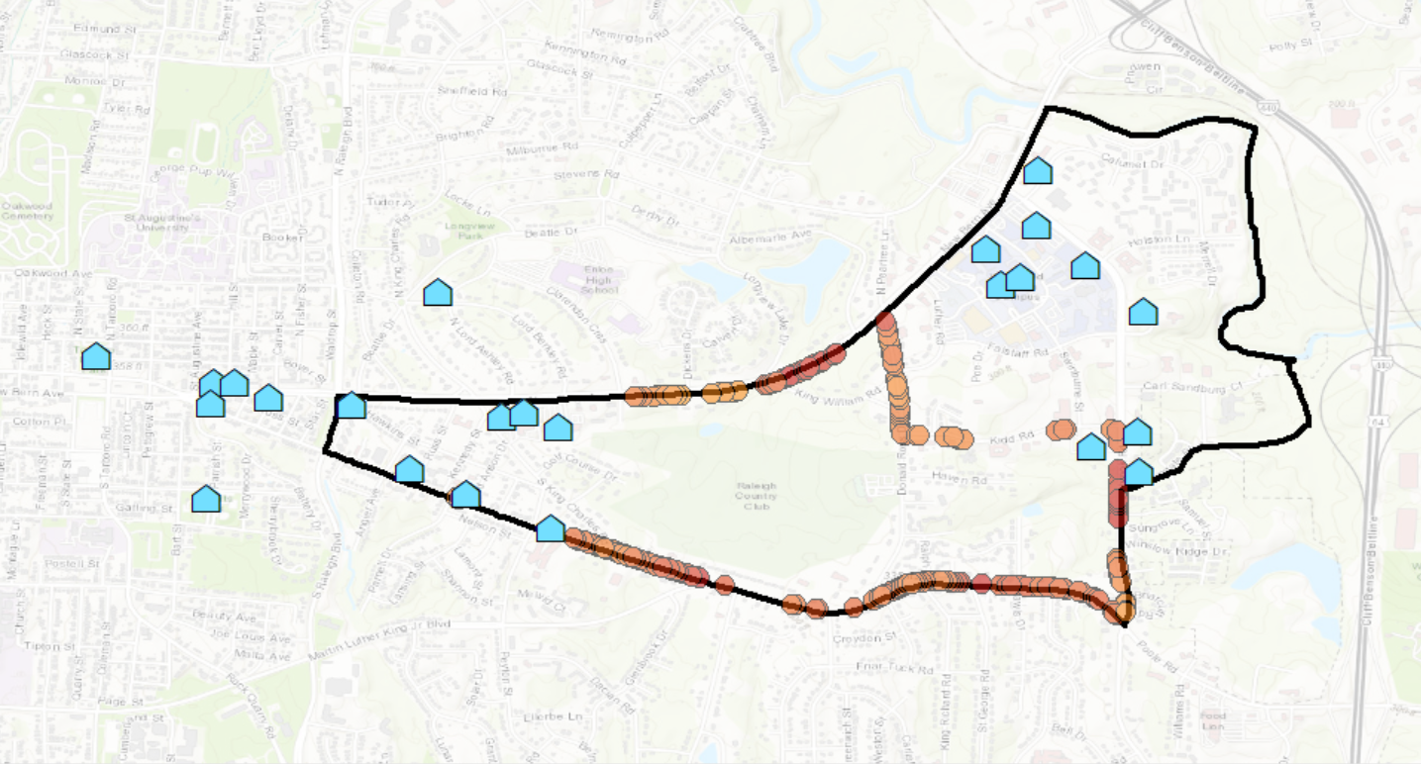

Heat distribution 3:00 pm
Census track Boundary

Slide 9
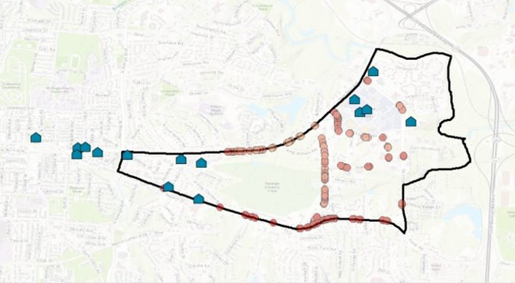

Heat distribution 7:00 pm
Census track Boundary

Slide 10
Conclusion
Aside the earlier morning; the outdoor temperature is unbearable in Longview Gardens.
The vulnerable population who heave rely on public transit will expose to heat while waiting at the bus station.
Although many heat shelter is open during the hottest hours of the day, they are not nearby the hotspot.
Limitation of this research: data coverage and consistency

